Slide 1
The Educational Presentation
Start with something inspiring to anchor the lesson
Relevant image
Thought question
Chart/graph

Slide 2
Purpose
Provide information to engage the learner
Why is material valuable/useful
Link with past and future learning

Slide 3
Review of Prerequisites
Background information
Assigned readings
Prior lectures
Essential skills
Physical exam skills
Patient interview skills

Slide 4
Statement of Objectives
State what learner is expected to learn
Define conditions for occurrence
Provide criteria for performance
In histology lab, correctly distinguish muscle cells from skin cells 80% of the time
Develop a DDX for XXX in hospitalized patients when XXX is present
Develop a long-term mgmt plan for XXX in hospitalized uninsured patients being discharged to the community

Slide 5
Presentation Overview
Outline lecture’s key points
Provides structure
Helps students organize information
Use as many slides as appropriate
Establish clinical relevance of content

Slide 6
Body of Presentation
As many slides as necessary
Short statements
Avoid complete sentences
Highlights only
Allow approx 2 minutes/slide

Slide 7
Application of Lecture Content
Approx every 15 minutes
Short activities during lecture (3 min)
Thought questions
Think-pair-share activities
Demonstrates relevance of information
Engages students
Refocuses attention
Improves learning by allowing students to apply learning/content

Slide 8
Concise summary of lecture
Recap major points
Relate points to learning objectives
Alternative- ask students to summarize as an end-of-presentation activity

Slide 9
References
Hyperlinks to online sources
Citations for non-electronic materials

Slide 10
Evaluation
Informal
Assess lecture effectiveness
Encourages learners to process material
“1 minute essay”
Solicited student feedback
Formal
Assess student learning
More highly structured
Performance on exams

Slide 11
Salt and pepper; not only in the kitchen
Katharina Beeler, MD
Tuesday Teaching
September 2017

Slide 12
Purpose
Objectives
Discuss pearls of systemic sclerosis
Understand epidemiology
Recognize presenting symptoms
Learn what impacts mortality
Describe Raynaud`s phenomena
Master diagnosis

Slide 13
Overview
Our patient
Follow up
Brief content review and pearls
Summary
Evaluation/wrap up

Slide 14
Our patient: History
76 y/o female
2 months history of dyspnea on exertion
Raynaud`s
Thickening of the skin
Generalized weakness and fatigue
Acid reflux, nausea

Slide 15
Our patient: PMH, PSH..
NIDDM, atrial fibrillation, depression, anxiety, multiple pulmonary embolism
PSH non contributory
Medications: acetaminophen, diphenhydramine, docusate sodium, furosemide, hydroxyzine, lisinopril, oxycodone, VKA (Warfarin)
FH: negative for autoimmune disorders

Slide 16
Our patient: Physical Exam
Afebrile, 156/82, 94bpm, RR 18,
Inspiratory fine crackles at the bases
Normal heart sounds, no m/r/g, no edema
T 97.7 HR 80 RR 16 BP 110/60, SO2 100% 2lpm of supplemental oxygen
Skin:

Slide 17
Our patient: Problem List
Dyspnea on exertion
Raynaud`s
Thickening of skin with salt and pepper appearance
Acid reflux, nausea
Generalized weakness and fatigue

Slide 18
Jeopardy...$100
What is the most common symptom complex in a patient with systemic sclerosis?
What is...?
Generalized symptoms, depression, headache
Raynaud`s, diarrhea, digital necrosis
Skin sclerosis, generalized symptoms, Raynaud`s

Slide 19
What are common symptoms
Raynaud`s phenomena (100%)
Arthralgias (96%)
Dysphagia (87%)
Atrophic changes of skin, hyper-/hypopigmentation (83%)
Anemia (31%)

Slide 20
Our patient: workup
TTE: EF 60%, right ventricular systolic pressure estimated @ 60mmHg plus CVP
HRCT chest: possible NISP pattern, possible interstitial edema (CT chest PE protocol negative for pulmonary embolism)
Right heart catherization: mildly elevated pulmonary artery pressure, mild-moderate pulmonary arterial hypertension
Serologies: positive ANA, titer 1:1280 (homogenous, nuclear pattern), positive anti Scl 70 Ab
ABG: pO2 39 mmHg, SO2 74%, pCO2 39 on room air
Screening for malignancy: thyroid nodules (adenoma), hypodense liver lesion (MRI pending)
Creatinine normal, no proteinuria or hematuria

Slide 21
Our patient: Problem List Revised
Dyspnea on exertion with acute hypoxic respiratory failure: secondary to mild to moderate pulmonary arterial hypertension, possible pulmonary edema and NSIP
New onset systemic hypertension
Esophageal dysmotility
Diffuse systemic sclerosis?

Slide 22
Jeopardy…$200
What organ involvement is the leading cause of death in systemic sclerosis?
What is...?
Skin
Heart
GI tract
Lung
Kidney

Slide 23
Predictors of mortality
Male (caveat: men diagnosed later?)
Older age at diagnosis
Black patient
Diffuse/systemic variant
Early rapid skin thickening
Pulmonary arterial hypertension
Low mortality: limited disease (no renal, cardiac or pulmonary disease), negative anti-Scl-70

Slide 24
After hospital discharge...
Follow up with rheumatology: patient endorses fatigue and inability to walk more that a few steps at the time, constipation
Started on mycophenolate (methotrexate contraindicated secondary to NSIP)
Pulmonary referral for management of pulmonary arterial hypertension and NSIP
Swallow study, referral to GI

Slide 25
Jeopardy…$300
Which patient is more likely to be diagnosed with systemic sclerosis?
What are…?
20 yo Hispanic female
40 yo Caucasian male
80 yo Black male
40 yo Black female

Slide 26
Epidemiology
Estimated prevalence: 276/one million adults
Incidence: 19.3 cases per year per million adults
Prevalence significantly higher in woman than man and blacks than withes
Median survival: 11 years
Average age at onset of diagnosis: 52 (younger in blacks)

Slide 27
Jeopardy…$400
Which disease does not usually cause Raynaud`s phenomena?
What are…?
Mixed connective tissue disease
Dermatomyositis
SLE
Peripheral vascular disease
Sjogren's syndrome

Slide 28
Raynaud`s phenomena
Vasocontraction of the digital arteries, precapillary arterioles and cutaneous arteriovenous shunts
Ischemic phase: pale, demarcated skin limited to fingers
Starts after exposure to cold or stressful situation, spreads symmetrically
Reactive hyperemia: Rapid reflow of blood into the digits

Slide 29
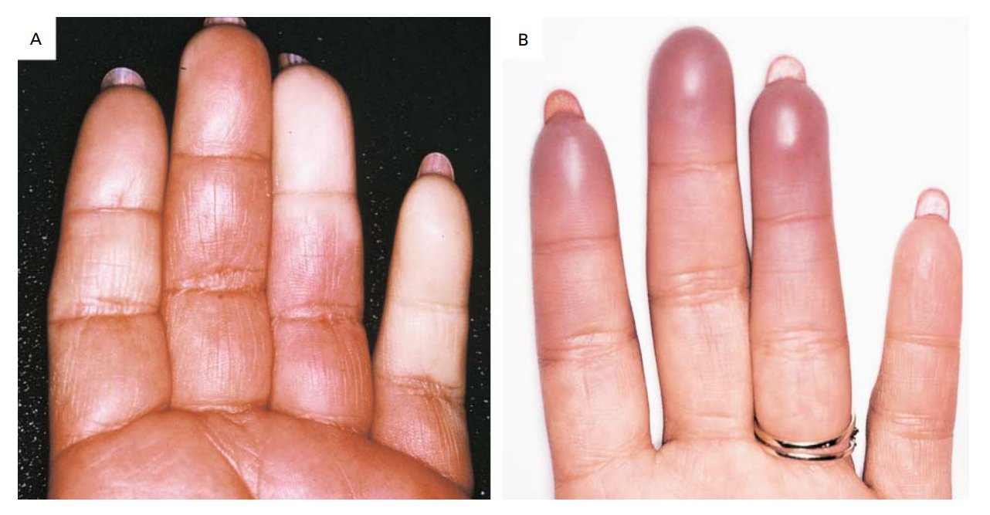

Slide 30
Jeopardy…$500
Systemic scleroderma is diagnosed by the presence of certain criteria, which criteria carries the highest weight?
What are…?
Raynaud`s phenomena
Scleroderma related antibodies
Abnormal nailfold capillaries
Skin thickening of the fingers of both hands extending proximal to the MCP joints

Slide 31
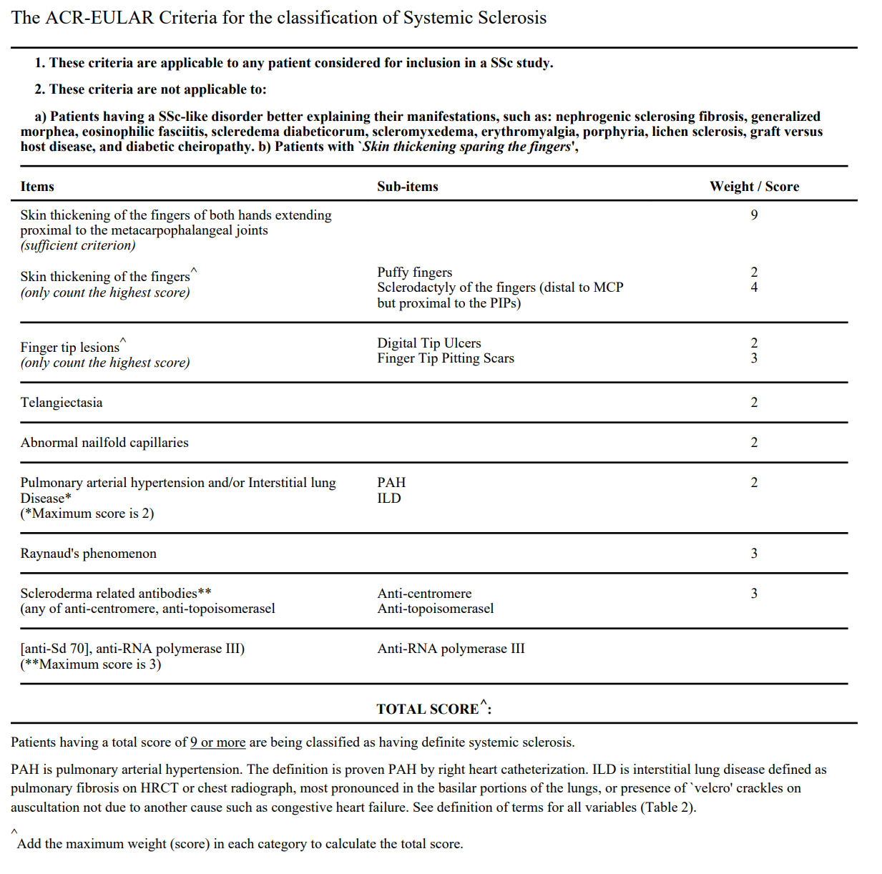
The ACR-EULAR criteria
Skin thickening of both hands extending proximal to the MCP joints
Finger tip lesions
Telangiectasia
Abnormal nail fold capillaries
PAH, ILD
Raynaud`s phenomenon
antibodies

Slide 32
Summary
You will know it when you see it
Presenting symptoms can be vague and affect any body part
Scleroderma is a rare disease
Diagnosis is made by different clinical criteria

Slide 33
Evaluation
Develop a quick task/activity to evaluate learning as a result of this presentation

Slide 34
References
List here

